Slide 1
Neural Networks &
Genetic Algorithms
Bujor Pavaloiu

Slide 2
Content (1)
1. Artificial Intelligence, Machine Learnig, Connectionist paradigm
2. McCulloch & Pitts neuron model. Perceptron
3. Adaptive Linear Neurons
4. Feed-Forward Neural Networks, Backpropagation
5. Deep Learning
6. Competitive learning Kohonen Self-Organizing Networks
7. Hopfield Networks
Neural Networks & Genetic Algorithms

Slide 3
Content (2)
8. Genetic Algorithms (1)
9. Genetic Algorithms (2)
10. Classification Problems
11. Approximation Problems
12. Clustering Problems
13. Transfer Learning
14. Hardware Acceleration
Neural Networks & Genetic Algorithms

Slide 4
Artificial Intelligence
Plainly, Artificial Intelligence (AI) is the ability of digital systems to learn and to take decisions.
The term was introduced by John McCarthy in 1955. It defined AI as “the science and engineering of making intelligent machines”
Components:
  Rule-Based Decision Making
  Statistical Reasoning
  Machine Learning
Neural Networks & Genetic Algorithms

Slide 5
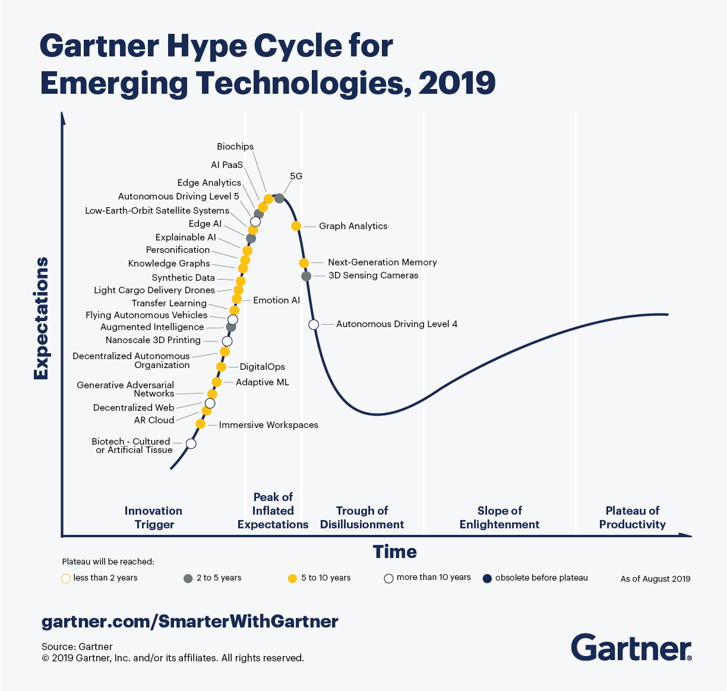
Many AI tools are in Gartner Hype Cycle
Neural Networks & Genetic Algorithms

Slide 6
Machine Learning
Machine Learning (ML) builds a mathematical model that can adapt using the input data in the process of learning.
In 1959, Arthur Samuel defined ML as the “field of study that gives computers the ability to learn without being explicitly programmed”
Neural Networks & Genetic Algorithms

Slide 7
Neural Networks
Artificial Neural Networks (ANNs or just NNs) or are a set of structures and algorithms inspired from the biological brain and designed to recognized patterns, cluster data or others.
Within an ANN, a neuron is a mathematical function that model the functioning of a biological neuron. Typically, a neuron computes the weighted sum of its inputs and pass it through a nonlinear function, called activation function.
Neural Networks & Genetic Algorithms

Slide 8
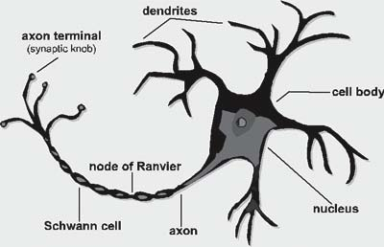
Biological Neuron
Neural Networks & Genetic Algorithms

Slide 9
Biological Neuron
Dendrite: Receives signals from other neurons
Soma: Processes the information
Axon: Transmits the output of this neuron
Synapse: Connection between neurons
Neural Networks & Genetic Algorithms

Slide 10
Hebb Learning Rule
Hebb 1949, Organization of behaviour:
When a cell A is near enough to excite cell B and repeatedly or persistently takes part in firing it, some growth process or metabolic change takes place in one or both cells such that A’s efficiency, as one of the cells firing B, is increased.
Biological neural systems are not born (completely) pre-programmed with all the knowledge and abilities.
A learning process takes place to incorporate new information.
Neural Networks & Genetic Algorithms

Slide 11
Connectionist approach
Individual neurons in a NN are interconnected through synapses.
The connections allow the neurons to signal each other as information is processed.
Each connection is assigned a connection weight.
If there is no connection between two neurons, then their connection weight is zero.
The weights determine the output of the neural network of a given input.
The connection weights form the memory of the neural network and allow it to function.
Neural Networks & Genetic Algorithms

